Slide 1

80 km/h
80 m
$$45°$$
80 m
113 m
3.6초 내에 정지해야 함.
80 km/h
자율주행 알고리즘이 정지 신호를 내리기까지 필요한 FPS: 10 (가정)
 | 10 FPS | 20 FPS | 30 FPS
지연 거리 | 22.2 m | 11.1 m | 7.4 m
남은 거리 | 58.8 m | 69.9 m | 72.6 m
남은 시간 | 2.6 초 | 3.1 초 | 3.27 초

Slide 2













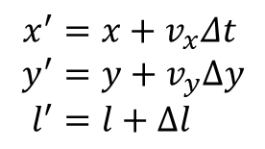



$$t=t_{0}$$
$$t′=t_{0}+Δt$$
$$v_{x}$$
$$v_{x}$$
$$\left(x,0\right)$$
$$\left(0,0\right)$$
$$\left(x′,0\right)$$
$$\left(0,0\right)$$
$$\left(y,0\right)$$
$$\left(y′,0\right)$$
$$θ$$
$$θ′$$
$$l$$
$$l′$$
$$v_{y}$$
$$v_{y}$$
$$x^{′}=x+v_{x}Δt \\ y^{′}=y+v_{y}Δy \\ l^{′}=l+Δl$$

Slide 3
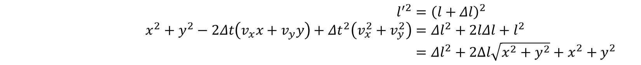
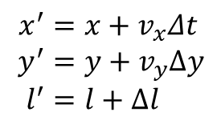

$$x^{′}=x+v_{x}Δt \\ y^{′}=y+v_{y}Δy \\ l^{′}=l+Δl$$
$$l^{′2}={\left(l+Δl\right)}^{2} \\ x^{2}+y^{2}−2Δt\left(v_{x}x+v_{y}y\right)+Δt^{2}\left(v_{x}^{2}+v_{y}^{2}\right)=Δl^{2}+2lΔl+l^{2} \\ =Δl^{2}+2Δl\sqrt{x^{2}+y^{2}}+x^{2}+y^{2}$$
$$\left(v_{x}^{2}+v_{y}^{2}\right)Δt^{2}−2Δt\left(v_{x}x+v_{y}y\right)−2Δl\sqrt{x^{2}+y^{2}}−Δl^{2}=0$$
Solving for $Δt$ gives
$$Δt=\frac{1}{v_{x}^{2}+v_{y}^{2}}\left[\left(v_{x}x+v_{y}y\right)−\sqrt{{\left(v_{x}x+v_{y}y\right)}^{2}+\left(v_{x}^{2}+v_{y}^{2}\right)\left(2Δl\sqrt{x^{2}+y^{2}}+Δl^{2}\right)}\right]$$

Slide 4


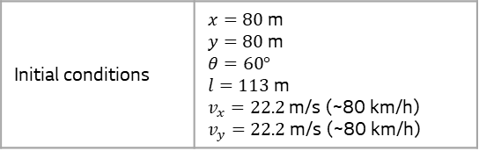
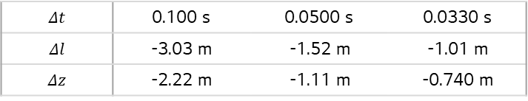
$$v_{y}$$
$$15°$$
Vertical FOV
$$Δt$$ | 0.100 s | 0.0500 s | 0.0330 s
$$Δl$$ | -3.03 m | -1.52 m | -1.01 m
$$Δz$$ | -2.22 m | -1.11 m | -0.740 m
Initial conditions | $x=80$ m $y=80$ m $θ=60°$ $l=113$ m $v_{x}=22.2$ m/s (~80 km/h) $v_{y}=22.2$ m/s (~80 km/h)

